Slide 1
Oksana Stepanova
Case Study
World Happiness: Data analysis of the factors that contribute the most to the happiness level
GitHub

Slide 2
Project Overview
What is happiness?
Positive psychology defines the happiness as the positive emotions we have in regard to the pleasurable activities we take part in through our daily lives.
Dr. Martin Seligman, a father of positive psychology, use the model based on five components of subjective wellbeing: Positive emotions, Engagement, Relationships, Meaning, Accomplishment.
Project scenario
Many people would like to move to another country for a long term without establishing permanent residency there. Among their objectives, there are traveling, working, studying, and temporary stay in a country with comfortable climate, but all of them give their preference to a country where the living conditions will contribute to their happiness.
There are two main categories: retired people, whose main criteria are safety, good social relationships and access to high quality medical services. Another group is young people, and their aspirations are good salary, low costs of living and freedom of choice.

Slide 3
Data – Tools - Skills
Data
World Happiness Report
Skills
Python Machine Learning Visualization | Sourcing data, preparing data for analysis, defining questions to explore
 | Creating correlation matrix, heatmap, scatterplot and pair plot, categorical plot to explore relationship between variables
 | Creating choropleth map with Python for geographical analysis
 | Splitting the data into training and test sets, running a linear regression, analyzing the model performance statistics
 | Using the elbow technique, running the k-means algorithm, creating visualizations for clusters, calculating descriptive statistics.
 | Decomposing the time series, conducting Dickey-Fuller test, stationarizing non-stationary data
Tools
Python
Jupyter Notebook
Pandas & NumPy
Matplotlib
Seaborn
Scikit-learn

Slide 4

Data cleaning – Merging – Data profile
Data cleaning and wrangling
Dropping the columns that are irrelevant for the analysis.
Renaming columns to unify the DataFrames
Adding the column ‘year’ for further merging
Converting data type to get the variables suitable for descriptive analysis.
Column name | Description | Data type | Time Variant
country | Country of measurement | Qualitative, nominal | No
year | Year of measurement | Quantitative, discrete | Yes
happiness_rank | Country rank based on the happiness score | Quantitative, discrete | Yes
happiness_score | The national average response to the question of life evaluations | Quantitative, continuous | Yes
economy_GDP_per_capita | The score of purchasing power | Quantitative, continuous | Yes
family | The score of social support (or having someone to count on in times of trouble) is the national average. | Quantitative, continuous | Yes
health_life_expectancy | The score of healthy life expectancies at birth | Quantitative, continuous | Yes
freedom | The score of freedom to make life choices is the national average. | Quantitative, continuous | Yes
trust_government_corruption | The score of corruption perception measured as the national average. | Quantitative, continuous | Yes
generosity | The score of generosity (donations to charity) | Quantitative, continuous | Yes
dystopia_residual | The metric of happiness of the imaginary country Dystopia | Quantitative, continuous | Yes
Data merging and consistency check
Merging 9 DataFrames into one.
Checking the country names and renaming the countries to have consistent names of the countries in the merged DataFrame.
No mixed-type data has been found.
Replacing missing values with the mean value.
No duplicates have been found.
Data wrangling Python scripts
4

Slide 5
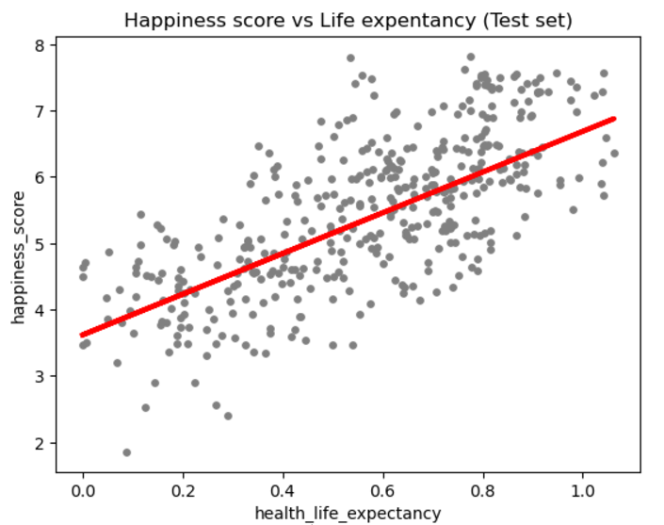
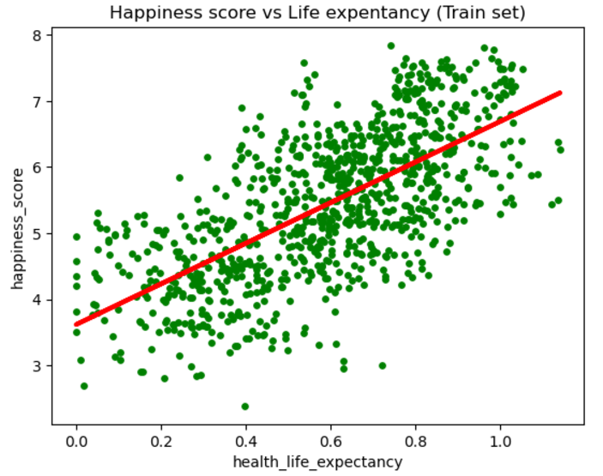
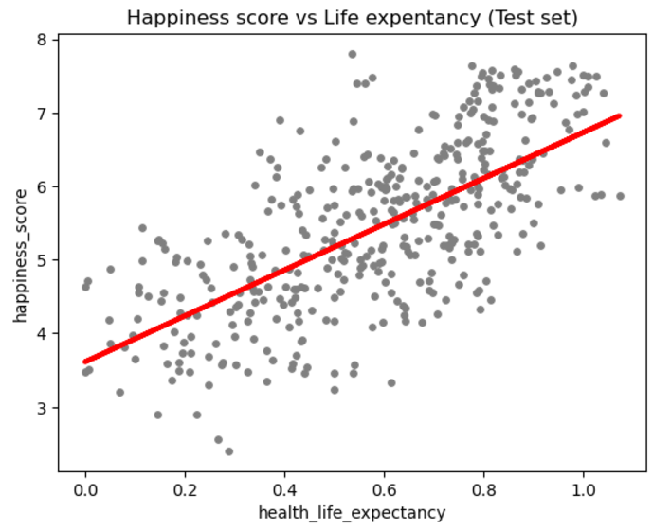
Supervised Machine Learning for Analysis Linear Regression
Reshaping variables into NumPy arrays
Comparing the real and predicted values
Improving model performance by removing outliers
Model summary statistics: Slop, MSE, R2 score
Plotting regression line on a test set
Splitting the data into training and test sets
Hypothesis: If the life expectancy factor is higher, then the country is more likely to have a higher happiness score.
Linear regression on a TEST set
Slope (3.0677) is positive: the relationship between X and Y variables is positive.
MSE (0.6693) : data points are not very close to regression line. The model is inaccurate due to a small dataframe of 1367 observations.
R2 score (0.4889) : moderate fit.
Compare how the regression fits TRAINING set
Slope (3.0677) : positive relationship.
MSE (0.6680) and a moderate R2 (0.4535).
The model is not overfitted.
This indicates that the life expectancy is correlated positively with the happiness score.
After REMOVING OUTLIERS
Slope (3.1178) : positive correlation.
MSE (0.6805) : datapoints are scattered far from the regression line.
R2 (0.4740) is slightly improved, but it indicates a moderate fit.
Model is inaccurate for this data set.

Slide 6
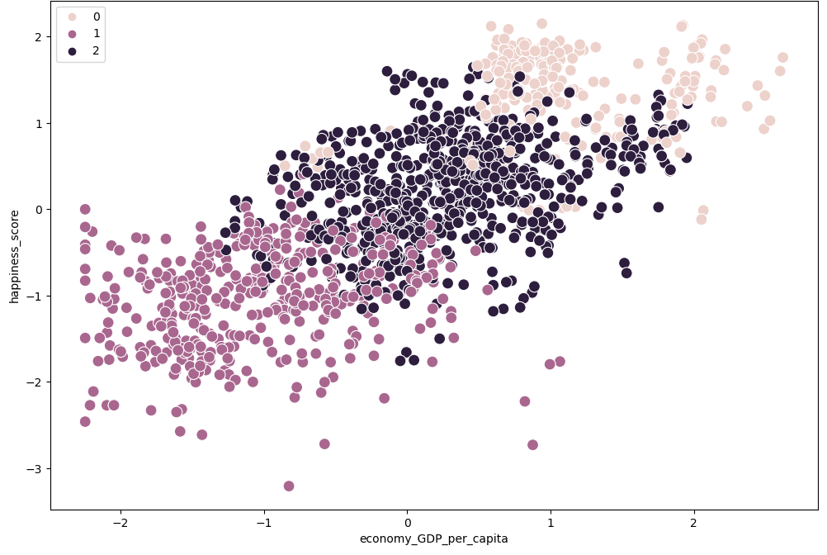
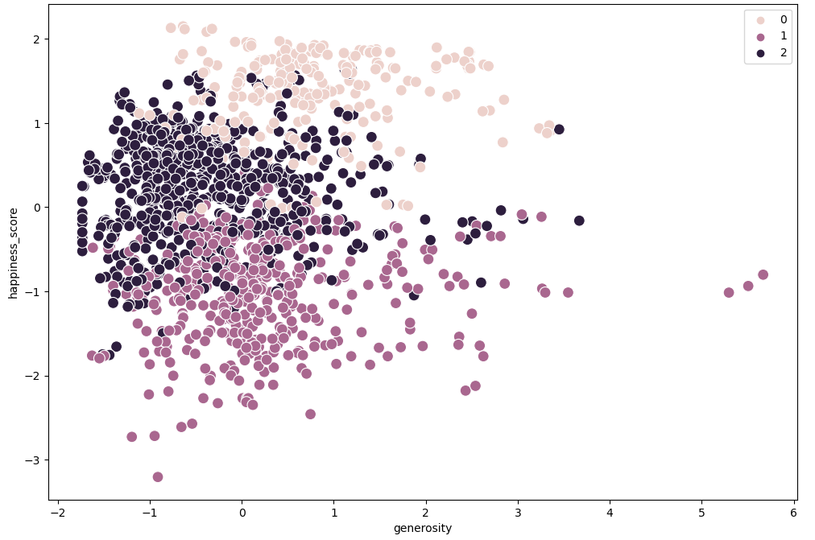
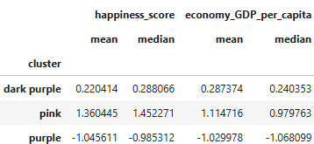
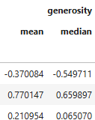
Unsupervised Machine Learning Clustering
Standardizing data
Checking the individual statistics of each cluster
Plotting the clusters
Applying k-means algorithm
Employing the Elbow technique
The elbow technique shows that line tends to flatten out on the x-axis after 3. Therefore, the optimal count for clusters is three.
The pink cluster returns the best stats. The median value of all variables is the highest. These data points are related to the countries with the highest happiness score.
The pink cluster is composed of countries having high level of happiness score, a high GDP and other happiness indicators
The dark purple cluster represents the countries with middle happiness score and middle GDP. However, the mean and median values of the generosity index is the lowest for this cluster.
The purple cluster is composed of countries with low happiness score and low GDP.
The graph shows the pattern of a positive correlation.
As long GDP per capita rises, the happiness score tends to increase as well.
No strong correlation is observed between the happiness and generosity.
The data point significantly pulled out at the left side of the graph where there are datapoints with a low level of generosity.
The impact of generosity level is weak on happiness.

Slide 7
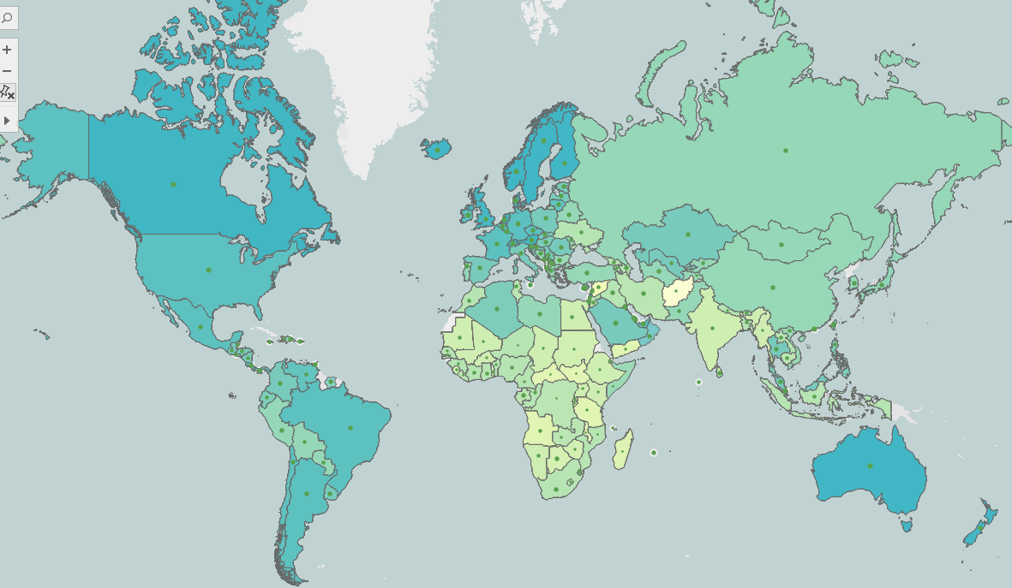
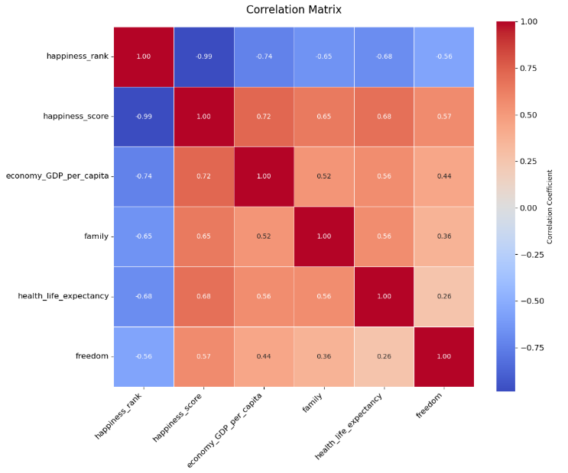
Data Visualization
Where do the happiest nations live?
The countries with the highest happiness score: Scandinavian countries, Canada, Australia, most European countries, UK, USA.
All these countries are economically developed and have a high level of GDP per capita.
A surprising fact that among the ‘happiest countries’ there are two island nations: New Zealand and Iceland. This could be also the result of the policy introduced by the government of Iceland and New Zealand aiming at moving to the wellbeing economy based on the growth of national wellbeing rather than GDP.
Which factors contribute the most to happiness?
The happiness score has the highest level of correlation with GDP per capita (0.72). GDP is a widely used indicator, it can be calculated using an accurate formula, and it is the least subjective among three other indicators used to rank happiness.
A strong correlation is noted as well between the happiness score and life expectancy (0.68), family and social support (0.65), freedom of choice (0.57). Such indicators as social relationship and freedom are subjective factors, nevertheless, when answering the survey questions, the correspondents are objective as it is related to their personal experience.
7

Slide 8
Recommendations & Insights
For the audiences who represent retired people aiming at traveling or temporarily staying in different countries for a long term and based on their preferences of good relationships and excellent medical services, I have analyzed the relationship between happiness score and life expectancy and social support.
Both factors have a strong positive correlation with the happiness score.
Nations with the highest life expectancy are not classified as the happiest counties. While social support contributes a lot to the people’s happiness in the counties from the top-20 list.
I would suggest that elderly people select a country of their destination from the top happiest counties and with a high social relationship level.
The top-10 countries are Finland, Denmark, Iceland, Norway, New Zealand, Ireland, Switzerland, Australia, Canada, Sweden.
For the younger generation, whose purposes in life are traveling & working or studying outside of the country of their residency and who defined their values as high paid salary and freedom, I have analyzed how GDP per capita and freedom of choice are correlated with the happiness score.
GDP per capita has the strongest correlation. Freedom has weaker, but positive correlation.
The highest level of GDP isn’t always compatible with the high happiness level. Moreover, five countries out of ten that reported the highest GDP score are ruled by autocratic governments. It is very unlikely that young people will be happy to stay there for a long term.
I would recommend that young people select a country of their destination from the top happiest counties and with a high freedom level.
The top-10 countries are Finland, Denmark, Iceland, Switzerland, Norway, Sweden, New Zealand, Canada, Australia, Costa Rica.

Slide 9

Thank you!
Oksana Stepanova
Links to more deliverables
Tableau visualization GitHub Repo

